Slide 1



Compare Transformation rules
Identify template Study
Identify template Table
Identify RAWp Spec issues
Data Dictionary on Data Mart
Madhu Allu

Slide 2
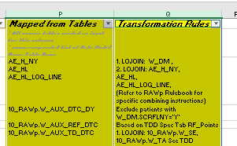
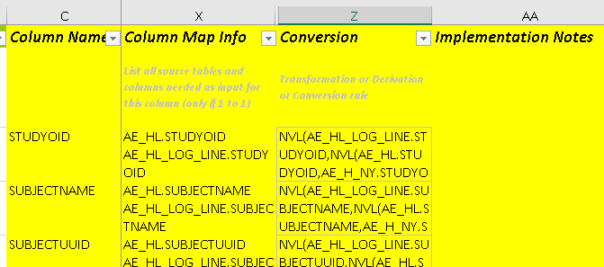
Compare Transformation rules between spec
Overview:
Compare structure and Transformation rules between spec
Compare on Table level ,columns level
Summary statistics and risk %
Input:
Source and Target study specs
Output:
What’s difference on Table level transformations ?
What’s difference on Column level transformations ?
How much % transformation rules matched between source and target study ?
Number of matched variables and % for each table
Number of missing and additional variables in backend
What’s risk % by table when copy transformation from source study ?
Identify when source variable not found
Define flag variables and set table comparison status

Slide 3
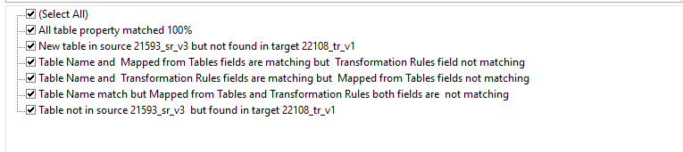
Table level transformations ?
Compare Source and Target Specs on table sheet by run R program using setup guide :
What’s difference on Table level transformations ?
Compare transformation rules on table workbook and return one of below category for each table
    All table property matched 100%
    Table Name and Mapped from Tables fields are matching but Transformation Rules field not matching
    Table Name and Transformation Rules fields are matching but Mapped from Tables fields not matching
    Table Name match but Mapped from Tables and Transformation Rules both fields are not matching
    Table not in source study but found in target study
    New table in source study , not found in target study

Slide 4
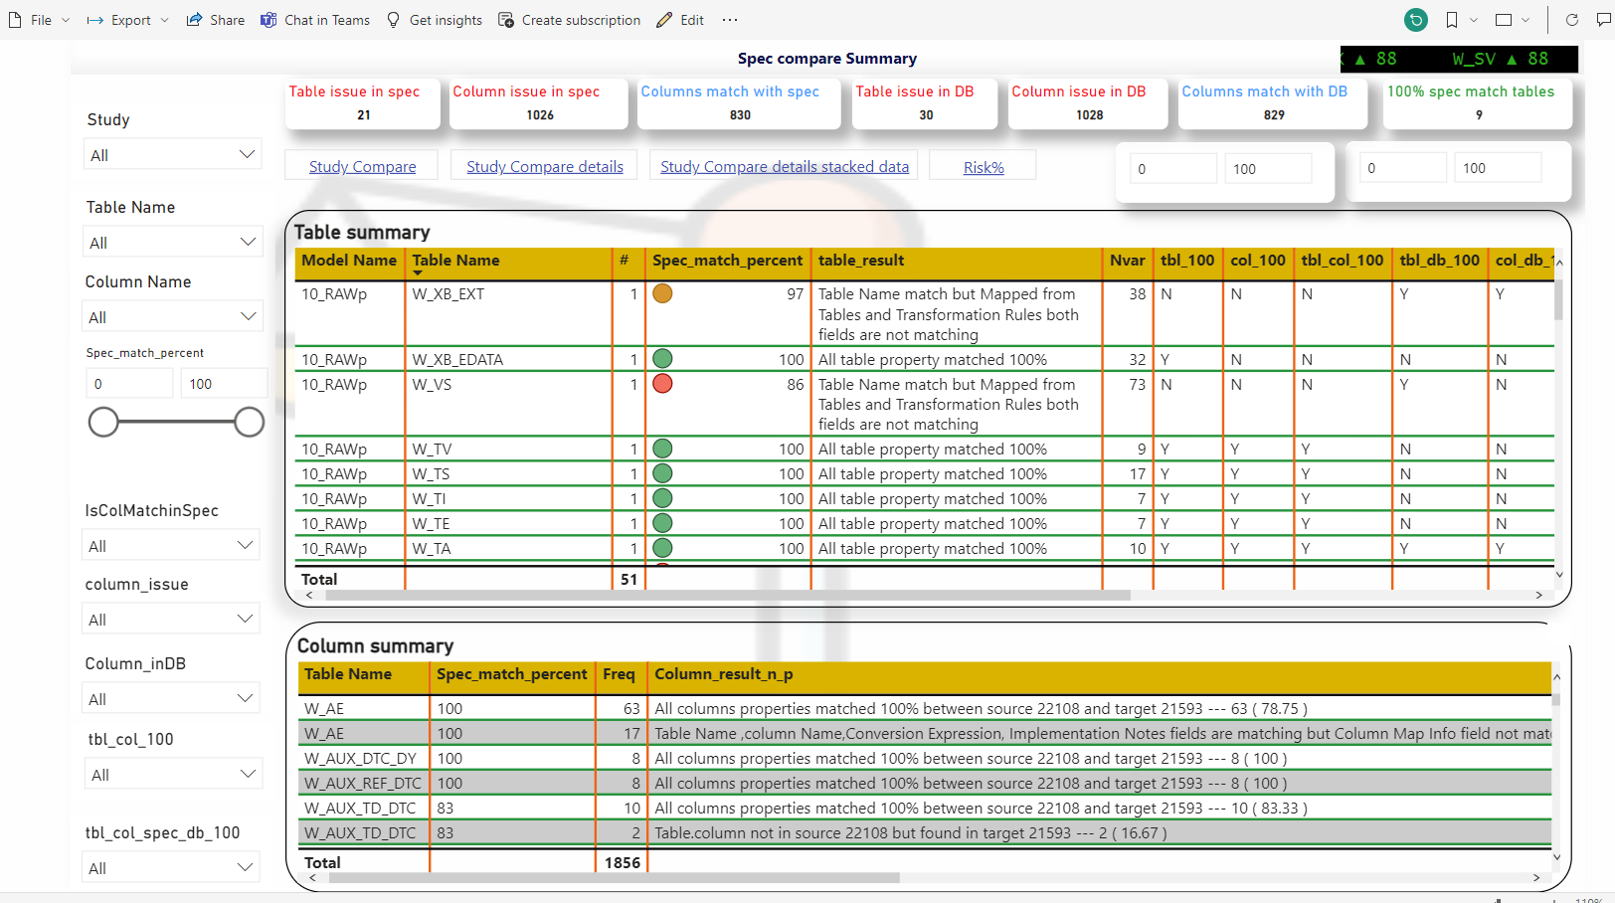
Visualizations

Slide 5
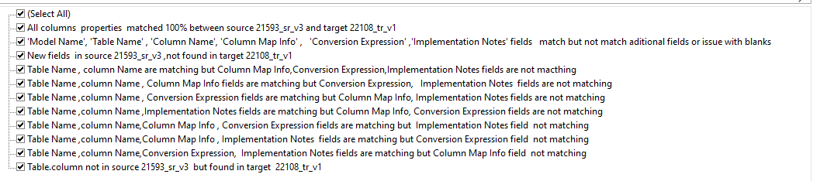
Column level transformations?
Compare Source and Target Specs on Column sheet by run R program using setup guide :
What’s difference on Column level transformations?
Compare transformation rules on column workbook and return one of below category for each column
    All columns properties matched 100% between source study and target study
    'Model Name', 'Table Name' , 'Column Name', 'Column Map Info' , 'Conversion Expression' ,'Implementation Notes' fields match but not match additional fields
    Table Name ,column Name, Conversion Expression, Implementation Notes fields are matching but Column Map Info field not matching
    Table Name ,column Name, Column Map Info , Conversion Expression fields are matching but Implementation Notes field not matching
    Table Name ,column Name, Column Map Info , Implementation Notes fields are matching but Conversion Expression field not matching
    Table Name ,column Name ,Implementation Notes fields are matching but Column Map Info, Conversion Expression fields are not matching
    Table Name ,column Name , Column Map Info fields are matching but Conversion Expression, Implementation Notes fields are not matching
    Table Name ,column Name , Conversion Expression fields are matching but Column Map Info, Implementation Notes fields are not matching
    Table Name , column Name are matching but Column Map Info, Conversion expression, Implementation Notes fields are not matching
    New fields in source study , not found in target study
    Table. column not in source study but found in target study

Slide 6
FAQ:
How much % transformation rules matched between source and target study ?
    Summary statistics (Number of variables &percentage )for each matched group by table
Number of matched variables and % for each table
    Structure % match by table
Number of missing and additional variables in backend
    Compare spec vs DB and return missing/additional columns in data model
What’s risk % by table when copy transformation from source study ?
    Risk % for each table when copy table without update Transformation rules
Identify when source variable not found
    Recognize source data model based on Spec and verify source table/column in DB
Define flag variables and set table comparison status
    Derived flag for each comparison level and define table comparison status is passed or failed

Slide 7
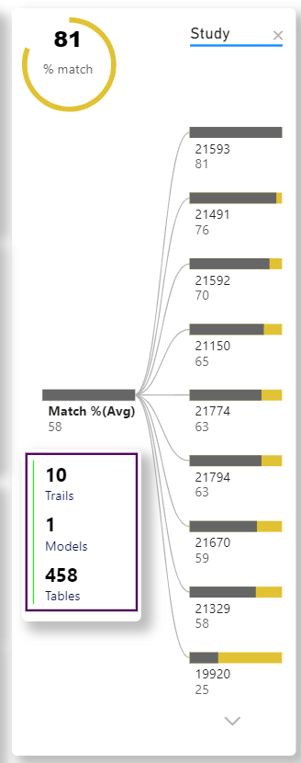
How to find Template study
Overview :
Find template study that has the highest % reusability .
Checks listed source studies in one go and return % reusability from each source study .
Input :
Need only table(Form) and column(Question) from each model
Extract 03_EDC metadata from listed source studies and target study to compare
Output :
Compare each table and column from source studies against target study and return summary statistics .
Compare each table and return number of additional tables by study, variables by table between source to target
Suggestion to identify source study :
Choose source studies with below eligible criteria
Choose study from same Bay# in Trail tracker
Same Combination of TA + Phase +Trial objective+ Trial design Factor list + Random blinded structure control variables in Trial tracker
Find rarely used CRF forms(tables) and search in EDC history (DB)
Ask study team if they know similar protocol !
*Prefer recent completed studies (at least QCM and P21 report shouldn’t have open issues) for Phase I-II

Slide 8
How It work ?
Follow steps in same sequence order :
Calculate template table %-> Return structure match % for each table in each source study
Compare target table structure match % in all listed source studies
Formula: Number of matched variables / number of unique variables from source and target
Calculate template Study based on template table match % calculation->Return structure match % by Study
Calculate Average of template table % group by Study by Data Model
Formula : Sum of template table % / Number of unique tables from source and target
Don’t choose Max % structure match study as template study -> Should review changes and decide
4. Review minimum number of new target tables against source at least for 5 studies -> Help what’s are table level changes
Recommended to consider recent completed studies at least in last 12 months for Phase 1-II.
Recommended to consider on-going studies also for Phase III-IV .
5. Decide which source study best fit to reuse -> Based on Minimal changes and open issues
Environment: Developed using R program . Need R studio IDE or R studio(Web application) to run program

Slide 9
Before start Study build activity
Recommended steps :
First load 03_EDC Data Model Metadata and data into DMW
Run Noise detector report and confirm no open issue between RAVE and DMW .
Identify template study and then apply template study .Don’t run sync utility at this stage.
Data Model “03_EDC_1”will be appear in DMW because it’s template study copy .Delete “03_EDC_1” Data Model.
Identify spec issues in RAWp and follow-up with Standards team to fix .
'Column Map Info','Conversion Expression' & 'Implementation Notes' fields are NULL.
Source table/column specified in RAWp not find in RAVE.
6. Dry run of Sync utility (Preview ) on RAWp
Return how many columns /tables dropped/added between target and source study .
If any table/columns missing in RAWp spec, please review and confirm before drop by sync utility .
7. Run sync utility now
8. Start Study build activities
9. RAWp spec compare report to detect what’s difference between target and source study .It helps to re-use transformations.

Slide 10
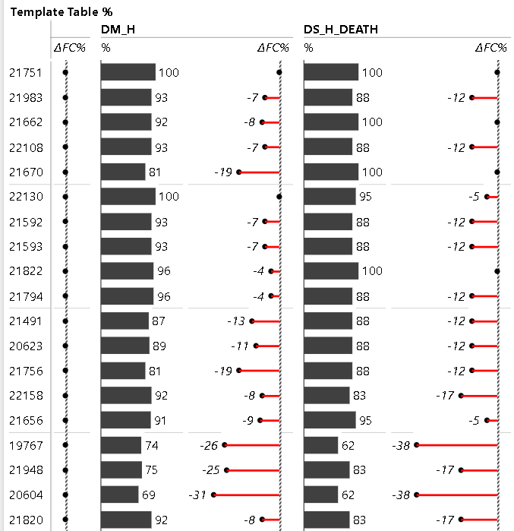
How to find Template Table
Problem Statement:
If target table not in template study , which source study use to copy transformation?
If target table have better structure match % in Non-template study , can we copy?
Overview :
Find template Table that has the highest % reusability .
Checks listed source studies in one go and return % reusability from each source study .
Can compare Any model and multiple models in one go
Input :
Need table(Form) and column(Question) from Data Model for Source and Target Study
Output :
Compare each table and column from source studies against target study and return summary statistics .
Compare each table and return number of additional variables between source to target

Slide 11
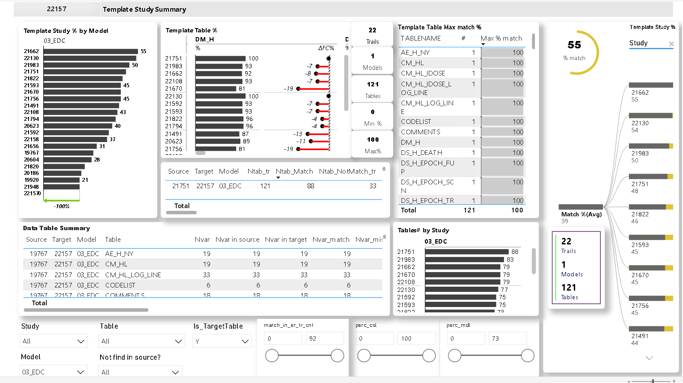
Find Template Table & Study

Slide 12
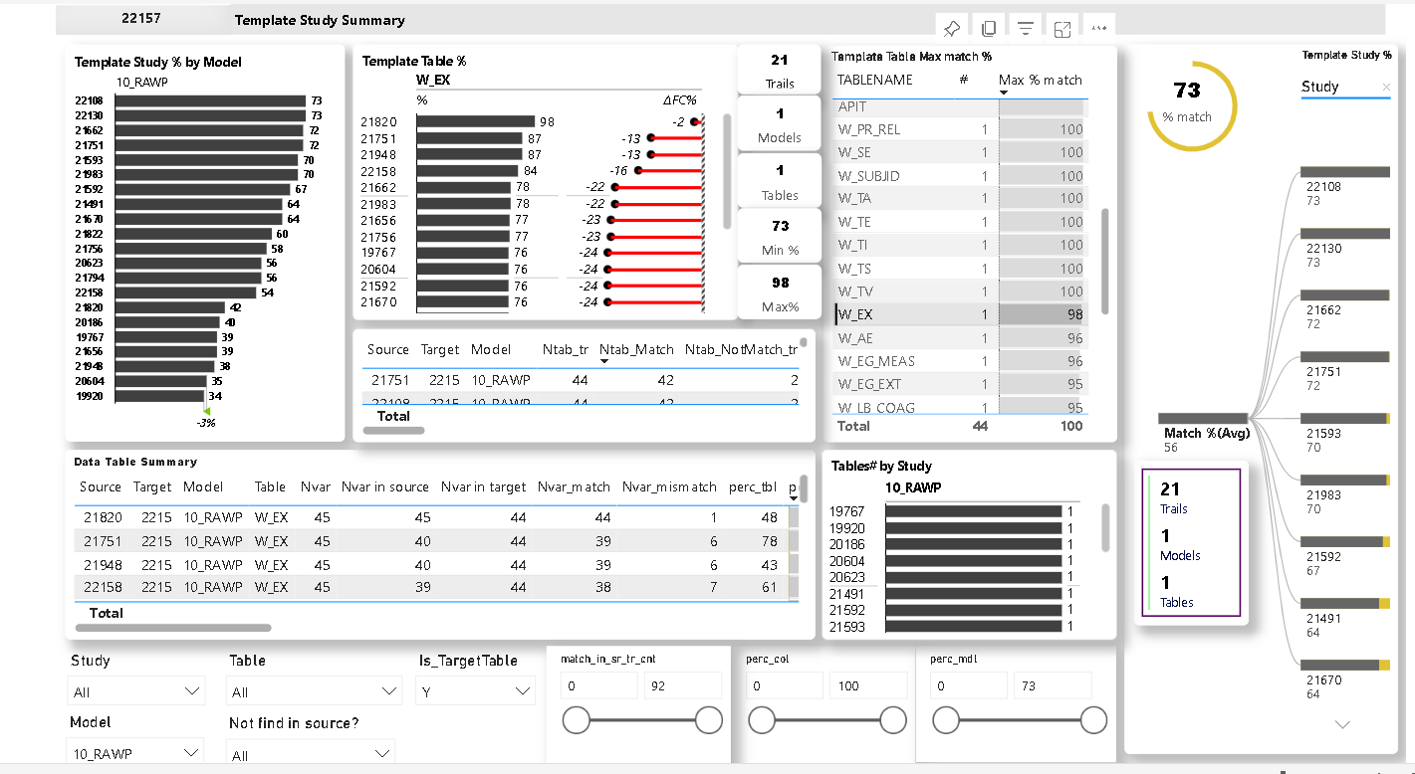
Template Table Analysis by Study level

Slide 13
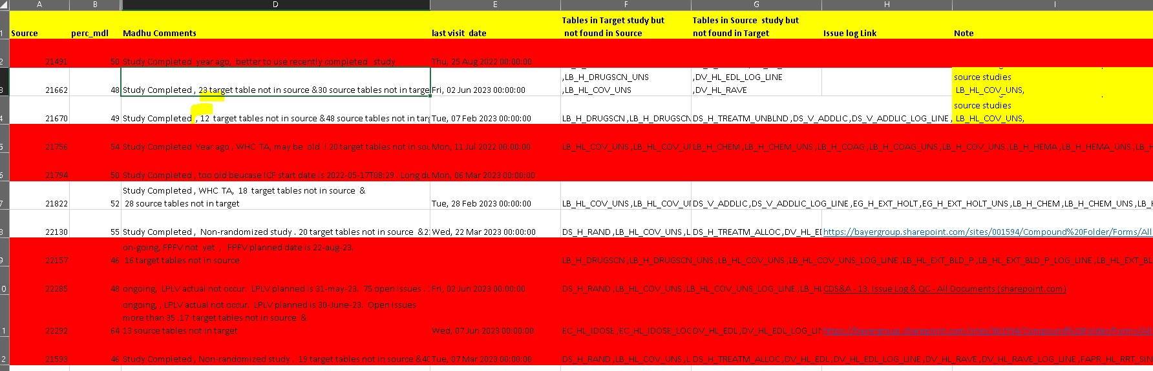
Review changes and decide

Slide 14
How to find Spec issues in RAWp
Overview:
Check if any column have column map info and conversation expression and Implementation fields are NULL
Check if specified source table/column in RAWp spec not exist in source
Check if any variable in source not used in RAWp spec - specially from RAVE source
Input :
Need RAWp spec
Need Metadata from target study Data Models
Output :
column map info and conversation expression and Implementation fields are NULL .
source table specified in RAWp spec not find in DB
source column specified in RAWp spec not find in DB
source table found but column specified in RAWp spec not find in DB
Additional variables in source data model never used in RAWp spec –specially from RAVE source .

Slide 15
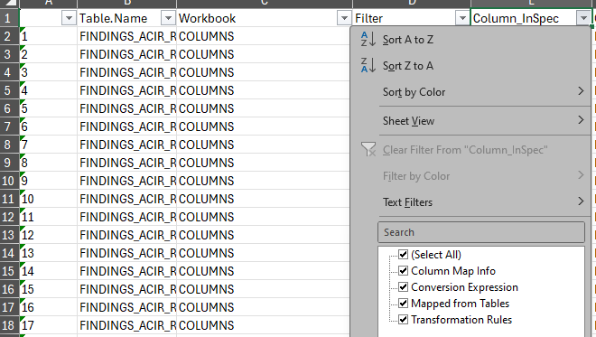
How It work ?
Follow steps in same sequence order :
1. Create Source_Dataset with below columns
Source Data Model, Source Table, Source column,
Table_InSpec, Workbook_InSpec, Column_InSpec, Org_Value_in_Spec, IsValidTable
Import RAWp spec, then Merge Tables and Columns workbook by Table and fill data in below columns
Table_InSpec, Workbook_InSpec, Column_InSpec, Org_Value_in_Spec
Rest of columns have NULL value at this stage
3. Remove below characters/words from Specified columns in spec .
Mapped from Tables:
"LJOIN","LOJOIN","1.1TO1:", "1TO1" ,"1. ","2. ", "2.", " ", "4.", "5.", "6.","7.", "8.", "9.", ":","|",")","(","="
"All relevant tables based on Guideline for SE Calculations","PROVIDER NOT YET SELECTED","%","?","12",".%","=“
Transformation Rules:
"LJOIN","LOJOIN","1.1TO1:", "1TO1" ,"1. ","2. ", "4.", "5.", "6.","7.", "8.", "9.", ":" ,"|",")","(","%","?","12",".%","="
"(Refer to RAWp Rulebook for specific combining instructions)", "Exclude patients with W_DM.SCRFLNY='Y'" ,"Based on TDD Spec Tab RF_Points", "10_RAWp.W_TA See TDD Specification add_Epoch_conditions for additional EPOCH Assignment guidances.", "(Filter to exclude BLANK_REC=ENTERABLE BLANK)", "See Guideline for SE Calculation", "PROVIDER NOT YET SELECTED", "EJOIN","LIKE '%MLM%' JOIN by STUDYID,SUBJECTNAME,VISITNR,LBDTC,LBEDCS, LBTPTC_DECOD,additional criteria for unscheduled visits required. Use RPL_LB_FORMTEST to join between W_LB_EXT and W_LB_EDATA based on FORMOID and testcode", "1a.", "1b.", "where", "If" ,"!","No", "=","MANUAL UPDATE NEEDED","Refer to RAWp Rulebook for specific combining instructions","PJOIN", "RECORDS","PROCESSING","RESULTS", "EXPECTED","SINCE","AFTER","EXIST")

Slide 16
How It work ?
Remove below characters/words in spec .
4.Columnmapinfo:
"LOJOIN", "1TO1" , "3.", "4.", "5.", "6.","7.", "8.", "9.", ":","|",")","(" ,"<",">“
5. ConversionExpression:
"If measurement field is not NULL then use global function?BayerStudyUtils.fn_getMUnit?to look up Unit?Decod","decode","Use global function", "BayerGeneralUtils", "<Source Table>", "<Source Table>.", "Use global function BayerGeneralUtils.fn_SDTM_ISO with input parameter", "if available in table","Use global function BayerTechUtils.fn_getStudyVisit", "Use global function BayerStudyUtils.fn_Lookup_Decode with input parameter", "Use global function BayerGeneralUtils.fn_getStudyDay with input parameter", "Use global function BayerRefUtils.fn_getPhase with input parameter","Populate using the table","Use BayerGeneralUtils.fn_getEmptyRecInd" ,"Default","Custom Function to calculate the DTCVAL relative day based on","See rules in RAWp rulebook","See TDD Specification Tab RE_Points for study Reference Dates in the Reference timepoint column","See TDD Specification Tab RE_Points for source of the Date based on the Reference Timepoint Pseudo Code","BayerTechUtils" ,"Use global function","fn_getStudyVisit","fn_getStudyDay","fn_getPhase","with input parameter","BayerStudyUtils","fn_Lookup_Decode ","If DTCVAL is a complete date/time value, else custom function to apply the?Min logic for partial date/time of the DTCVAL.","Min?date by SUBJECTNAME and EPOCH (based on applicable ELEMENTS) from W_SE, if min date is partial, then apply the","fn_getEmptyRecInd","BayerStudyUtils","fn_Lookup_Decode","Custom Function to","calculate","determine Phase","If measurement field is not NULL then use global function?BayerStudyUtils.fn_getMUnit?to look up Unit?Decod","fn_getMUnit","Min?date","Max?date","by SUBJECTNAME and EPOCH (based on applicable ELEMENTS) from W_SE","function")
"CHECKED ","NOT CHECKED","complete","date/time","If DTCVAL is a complete date/time value, else custom function to apply the?Max logic for partial date/time of the DTCVAL.","For qualitative results coming from checkboxes","For quantitative local lab tests, join with","to get lower limit","Unpivot function to include all lab test names from non-EDATA files., If Unpivot is a Checkbox variable and %_CB=1, then extract the Test Name by removing ?_CB? from the Test Name., For Check box variables, LBEDCS = REVERSE(SUBSTR(REVERSE(<Variable Name>),4)), , if missing, then LBEDCS='MISSING', , For 'NOT DONE' records LBEDCS='MISSING'","Study day based on","Use global function?BayerGeneralUtils.fn_getStudyDay?with input parameter","See Guideline for SE Calculation","Use SQL Expression RANK to derive STUDYOID from“
"If DTCVAL is a complete date/time value, else custom function to apply the Min logic for partial date/time of the DTCVAL.","Min date by SUBJECTNAME and EPOCH (based on applicable ELEMENTS) from W_SE", "if min date is partial, then apply the Min logic." ,"not all variables are part of each study: regard only items which occur“
For each test in EGTESTCD Value is populated from:", "Custom function to lookup BSP Label in XXFORMAT reference table based on" , "For qualitative results" , "If same value across records all records with same ECLNKID, use value from first record", "If multiple values across all records with same ECLNKID, use", "take from last record within ECLNKID","Custom function to look up Category from","If not found in SLAT“
"BayerRefUtils" ,"BayerGeneralUtils","BayerStudyUtils.fn_Lookup_Decode?with input parameter","BayerStudyUtils.fn_Lookup_Decode?with input parameter","fn_SDTM_ISO?with input parameter" ,"If same value across records all records with same ECLNKID, use value from first record","If multiple values across all records with same ECLNKID, use 99.“
".fn_SDTM_ISO","MISSING","custom","logic","extract","Function","missing","pivot test code from","Custom","populate","when","Original value contained in“
"TRIM(regexp_substr(" , ":space:", "[", "]", "$", "instr", "-", ">","then ","else","=" ,"for","when","default","MISSING“
"where", "Note that", "Derived from", "Numeric value only","use 99","01-Jan-1999","Use 500001, cannot be collapsed","NULL","Map from","Unpivot function to include all","'","Only NON NULL value“
"global","measurement","field","based on value in","'","Use function","Source Table","if available in table“
"Min?date" , "Max?date" ,"UPPER","Custom function to lookup BSP Label in XXFORMAT reference table based on","For qualitative results ","missing","nvL“
"NVL","nvl", "#",":" , "3.", "4.", "5.", "6.","7.", "8.", "9.", ":","|",")","(" ,"<",">","'","*",",","`","?","!","?","%","^","&","+","-","@","~","~",". .",".." ,"<." , ">.","?“

Slide 17
How It work ?
Follow steps in same sequence order :
6. Keep one space between word by remove all extra spaces
7. Split each word into separate row from Mapped from Tables, Transformation Rules, Columnmapinfo and ConversionExpression columns
8. Calculate number of ‘.’ in each word.
If it return as 3, then write first word as Data Model, second Word as Table and Third word as Column
If it return as 2, then write first word as Data Model, second Word as Table when source is Table workbook
If it return as 2, then write first word as Table, second Word as Column when source is Columns workbook
If it return as 1, then write first word as Table when source is Table workbook
If it return as 1, then write first word as Column when source is Column workbook
9. Consider below keywords are Valid source table to track back from results
"(_H_|_HL|_H.|_LOG_|W_|DM_H|IE_|DS_V_|SUBID|COMMENTS|EXCLUDEDDATA|LAB_ANALYTE|LAB_RANGES|MEASUREMENTUNIT|PROT_DEV|QUERY|RAVE_DISC_STAGE|SITE_LIST|PROT_DEV|DAVE.|KRP.|KARAPIT|TDD|03_LABS|SAS|10RAW)|_EDATA_|CDE_SAS|C_CD_|C_CQ_|C_GC_|EGHR1MIN_ED|RAND_REF|REF_EPOCH|RELREC_DEF|RPL_|STUDY_REF|STUDY_SPECIFIC_IME|CONV_VS|EQUIV_UNIT|SLAT|SYN_UNIT|VALIDITY_FINDINGS|TRUNIT|ZZ_EPOCH_|BLANK_REC|C_CV_|FAAE_H|GF_H|HO_HL|LB_H_|LB_HL_|OE_HL|PC_HL|QS_H|RS_H|SS_HL|TR_HL|TU_H“

Slide 18
How It work ?
Follow steps in same sequence order :
10. Consider below keywords belongs to specific Source Data Model in same sequence order
03_EDC INPUT MODEL:
"(_H_|CV_H.|CE_H.|_HL|_HL.|_LOG_|IE_|DM_H|SV_H|VS_H|ML_H|DS_V_IC|EC_HL_IDOSE|SUBID|SUBID.|COMMENTS|EXCLUDEDDATA|LAB_ANALYTE|LAB_RANGES|MEASUREMENTUNIT|PROT_DEV|QUERY|RAVE_DISC_STAGE|SITE_LIST|FAAE_H|GF_H|HO_HL|LB_H_|LB_HL_|OE_HL|PC_HL|QS_H|RS_H|SS_HL|TR_HL|TU_H)“
10_RAWP TARGET DATA MODEL:
W_|10RAW|DS_V_|RAWP|ZZ_CQ_
ZZ_SS TARGET DATA MODEL:
BLANK_REC
ZZ_SSREF TARGET DATA MODEL:
fn_Lookup_Decode
REFDATA INPUT DATA MODEL:
fn_GetStudyDecod
DAVE INPUT MODEL:
DAVE.|LT_EXPORT_DATA
KARAPIT INPUT MODEL:
KRP.|KARAPIT|_KARAPIT
CDE_SAS INPUT MODEL:
CDE_SAS|C_CD_|C_CQ_|C_GC_
03_LABS INPUT MODEL:
03_LABS
RAND_SAS INPUT MODEL:
RAND
REFDATA INPUT MODEL:
RAND_REF|REF_EPOCH|RELREC_DEF|RPL_|STUDY_REF|STUDY_SPECIFIC_IME
REF_CVTB INPUT MODEL:
CONV_VS|EQUIV_UNIT|SLAT|SYN_UNIT
XX_EDATA:
XX_EDATA_
TRUNIT:
TRUNIT
11. Assigned above Data Model when key word matched .when key word matched once, it will not execute in another step again.
Table and Column already assigned as part of Calculate number of ‘.’ in each word in previous step .

Slide 19
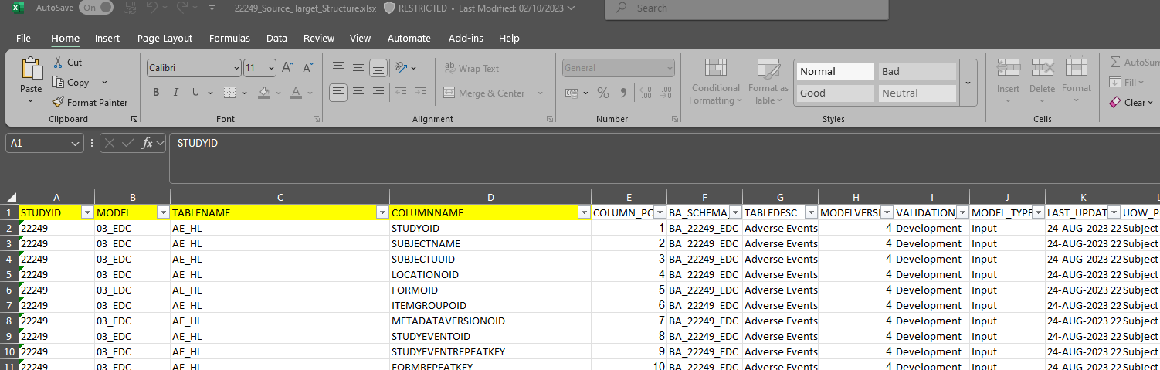
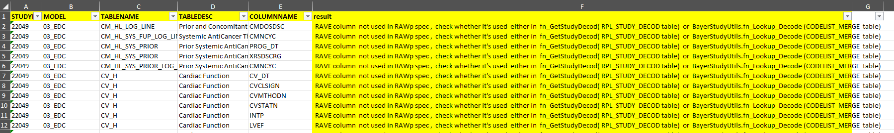
How It work ?
Follow steps in same sequence order :
12. Download Target Study metadata by execute SQL script .
It have Study name , Data Model, Table,Column as metadata in Target Table
13. Compare Difference between Target table and Source_Dataset Table on Data Model, Table and Column level .
Results are below category :
Data Model, Table and Column from spec matched with DB
Data Model, Table matched but Column from spec not find in DB .Please review .
Data Model Matched but Table from Spec not find in DB . Please review .
Table in DB not used in RAWp spec, Please review .
Table in DB used but column from same table not used in RAWp spec, Please review .
Is Valid table=‘N’ means Code can’t Auto detect , Please Review manually .

Slide 20
Data Mart
Overview :
Data dictionary on Data Mart . Report have summary statistics on Metadata(Data about Data ) level
Input :
Data mart option checkbox should be enabled in DMW
Output :
Number of tables
Number of rows in each table
Number of variables in each table
Number of missing and non missing values in each column
Summary of descriptive statistics
Frequency and percentages for Categorical variable
Mean, median, min, max, Std for Continuous variable
Can filter system(RAVE) defined variables
Can track all NULL variables in data model
Can track unique values in each variable
Can track which values are more proportion in each variable

Slide 21
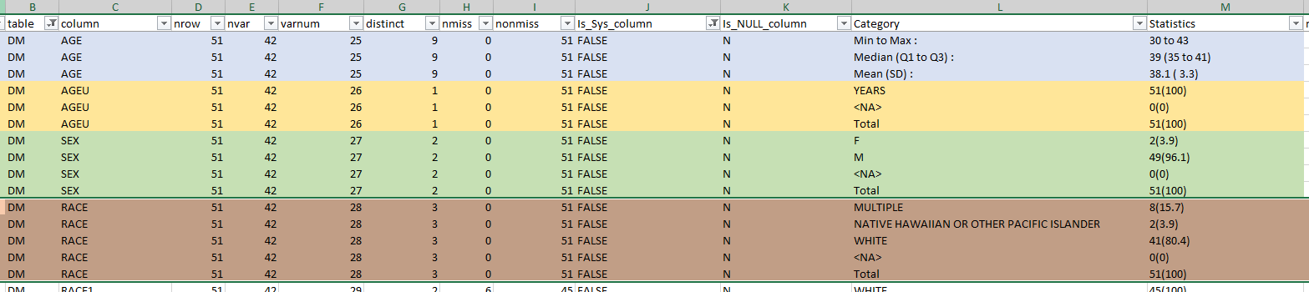
Data Mart
Field | Label | Use case
table | Table name
column | column name
nrow | number of rows | Make sure data loaded with at least one row
nvar | Number of variables | It validate total number of variables in spec Vs DMW(DB)
varnum | column name sorting order | It validate to verify column sorting order as per spec specially for 20_SDTMp consumer model
distinct | Count of unique values in variable | It help me to validate how data flow between source to target specially from RAWp to SDTMp . Also help me to validate code list
nmiss | number of NULL in variable
nonmiss | number of NOT NULL in variable
Is_Sys_column | Is Rave /DMW /system generated /common columns? | Rave common columns /DMW system generated columns
Is_NULL_column | Is Column have only NULL ? | Make sure to load source data to populate at least one non null unless spec specify load as NULL, Check transformation rules between source and target
Category | Show data options | Show data options for Descriptive/ summary Statistics . It return top n values for each variable based on parameter for categorical variables and summary statistics for continuous variables
Statistics | Calculate Descriptive/ summary Statistics based on data type | Calculate Statistics . It return top n values for each variable based on parameter for categorical variables and summary statistics for continuous variables

Slide 22
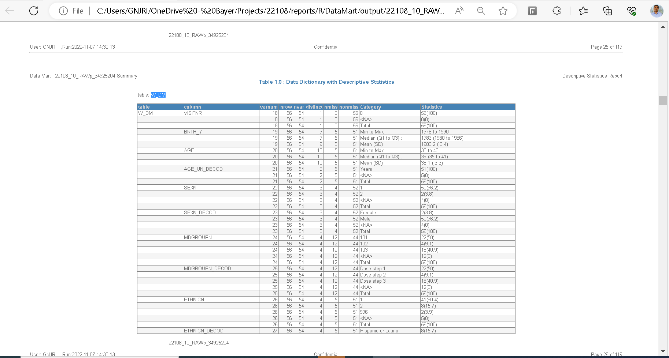
Data Mart

Slide 23


